Slide 1

Horizontal Diphthong Shift
in New Zealand English
Márton Sóskuthy¹, Jennifer Hay², James Brand²
¹University of British Columbia, ²NZILBB – University of Canterbury
Twitter: @msoskuthy · Email: marton.soskuthy@ubc.ca

Slide 2
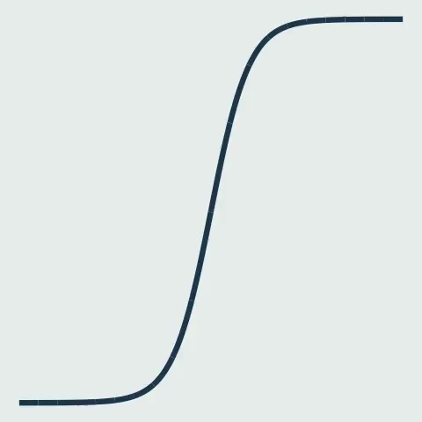
Vertical variation in diphthongs

Slide 3
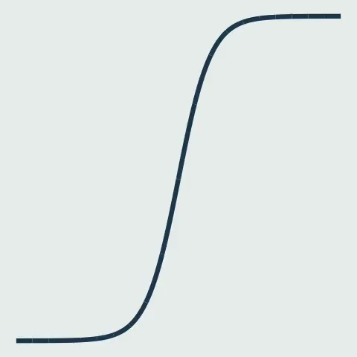
Horizontal variation in diphthongs
Peeters & Barry (1989); Fox & Jacewicz (2009); Cardoso (2015)

Slide 4
price and mouth in New Zealand English
price
F2
F2
mouth
F1
F1

Slide 5
price and mouth in New Zealand English
F2
price
F2
mouth
F1
F1

Slide 6
price and mouth in New Zealand English
Diphthong Shift
F2
price
F2
mouth
F1
F1
e.g. Wells (1982), Gordon et al. (2004)

Slide 7
Diphthong Shift
described as vertical shift
temporal dynamics:
are there any horizontal changes?
price and mouth changing in parallel?

Slide 8
Methods
__ [–voi] excluded
Generalised Additive Modelling
“any changes in the formant contours
over time?”
automatic extraction &
filtering of
F1 & F2 trajectories
539 speakers
(b. 1857–1988)
31,025 price
20,123 mouth
ONZE
“specifically horizontal changes in formant contours?”
Inflection point analysis

Slide 9
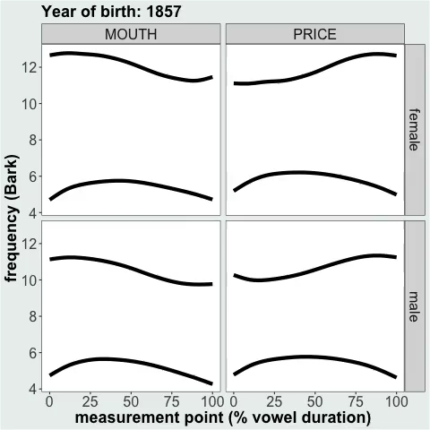
Generalised
Additive
Modelling
vertical shifts compatible with diphthong shift
horizontal shift in F1 maximum

Slide 10
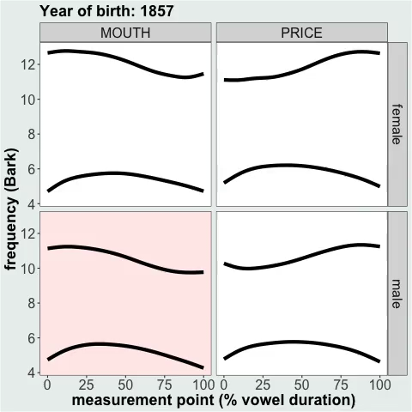
Generalised
Additive
Modelling
our auditory impression: lengthening of nucleus

Slide 11
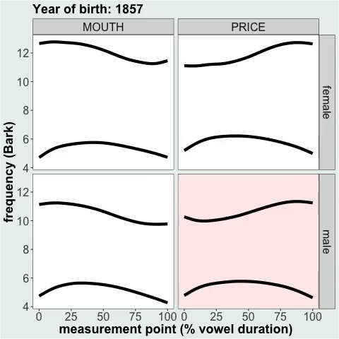
Generalised
Additive
Modelling
our auditory impression: lengthening of nucleus

Slide 12
Inflection point analysis
automated implementation of Cardoso (2015)
relies on first & second derivative of smooth curves

Slide 13
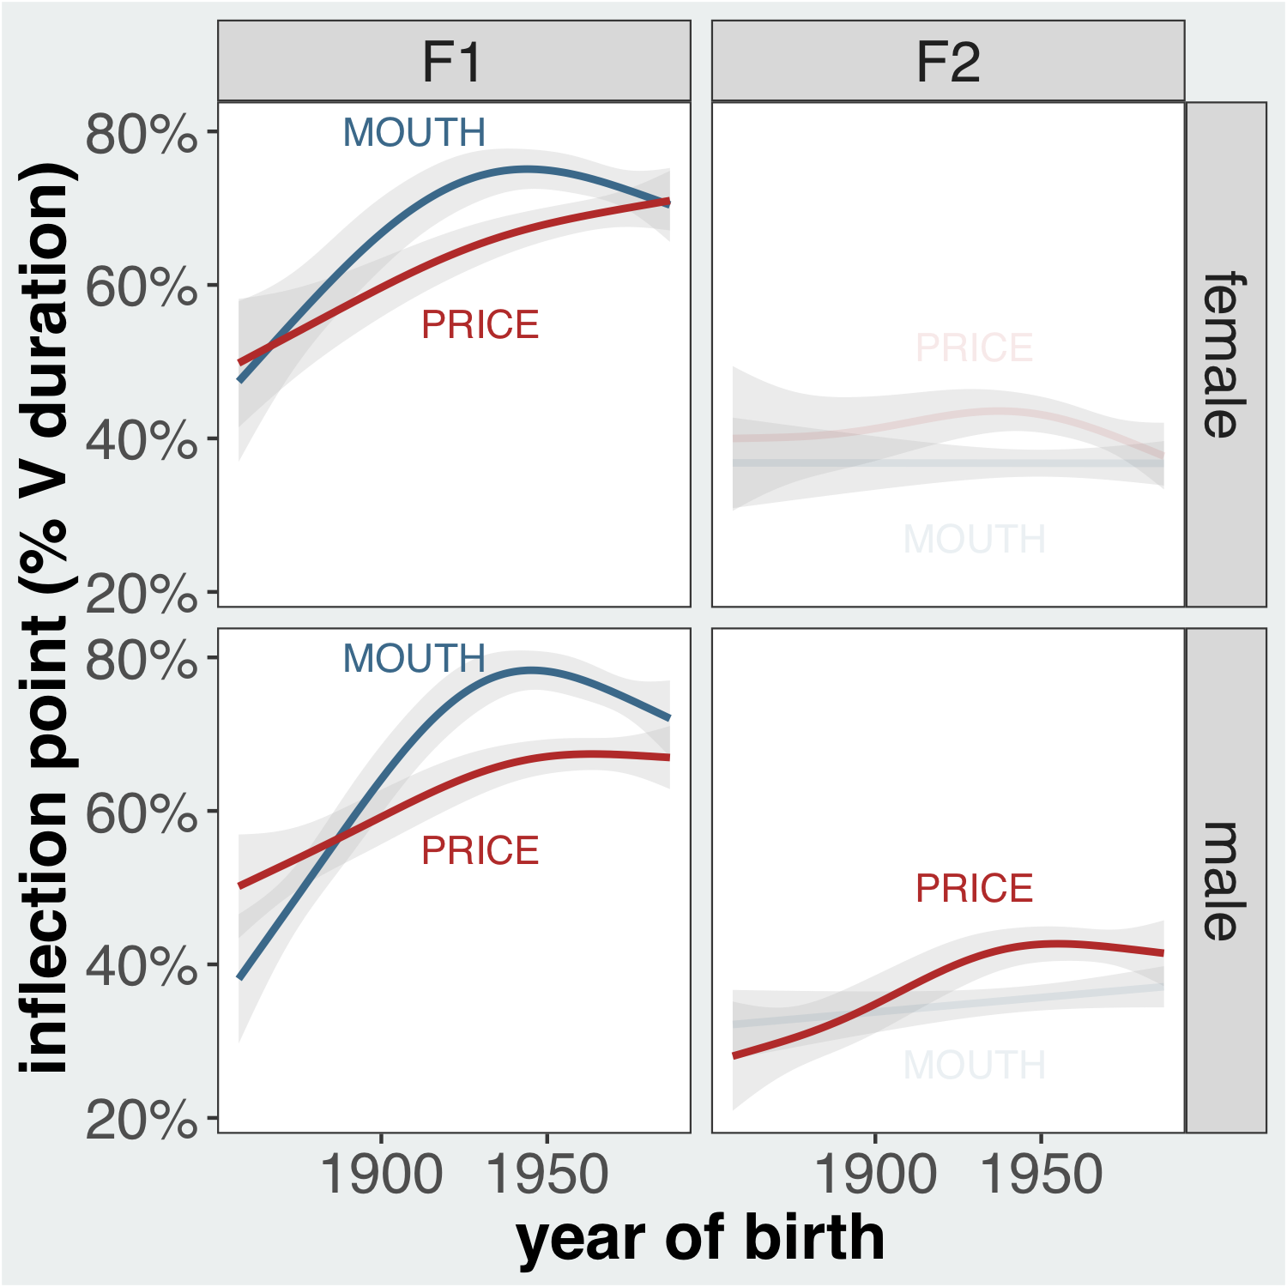
Inflection point analysis
strong evidence for shift in F1 inflection point for both price and mouth

Slide 14
Conclusions
substantial horizontal shift in F1 for price and mouth confirmed both by GAM and inflection point analysis
vowel resynthesis: useful data summary & sanity check for noisy data

